Slide 1


Behavior Analytic Tool Capabilities
Notes:
Image Source - https://www.google.com/search?q=hotjar+logo&rlz=1C1GCEA_enIN901IN901&sxsrf=ALeKk01QnjiDPGlc0GEv3CkHj4MQM9c2Pw:1597566550545&tbm=isch&source=iu&ictx=1&fir=nBWVg0U6ST4EkM%252CyBWhi847d-_RSM%252C_&vet=1&usg=AI4_-kR_T2P3EwUwNQZEazpQcyYzpumHBQ&sa=X&ved=2ahUKEwiS-P-Vp5_rAhURyDgGHXdQB74Q9QEwB3oECAsQMA&biw=1366&bih=625#imgrc=nBWVg0U6ST4EkM

Slide 2
Agenda
Hotjar
Hotjar Capabilities

Slide 3

Hotjar
Hotjar allows you to visualize how users engage with your site. Data-backed understanding of what exactly people are using your site for, and how they’re using it.

Slide 4
Hotjar Capabilities
Interactive heatmaps
Visitor recordings
Conversion funnel reports
Form analysis
Feedback polls
Surveys
Conversion rate optimization (CRO)
Web analytics
A/B Testing

Slide 5
Heatmaps
Heatmaps show you an aggregate of user behavior on individual site pages: where do your users click and scroll? What are they interested in? Do they see the most important elements of the page, and interact with them?
Heatmaps show a variety of insights into user behavior on your site. They show what areas of your pages are getting lots of attention, and which are getting less.
By showing where people are clicking, scrolling, tapping, and hovering, they display user behavior in a way you wouldn’t have otherwise seen.

Slide 6
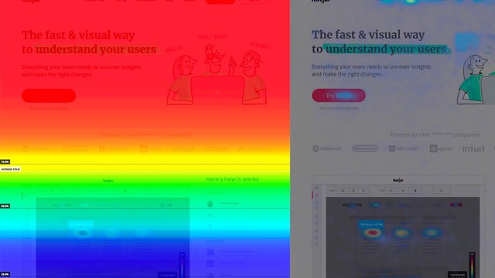




Heatmap
Notes:
Image source - https://www.hotjar.com/blog/what-is-hotjar/

Slide 7
Types of Heatmap
Click heatmaps
Move heatmaps
Scroll maps
Desktop and Mobile heatmaps

Slide 8
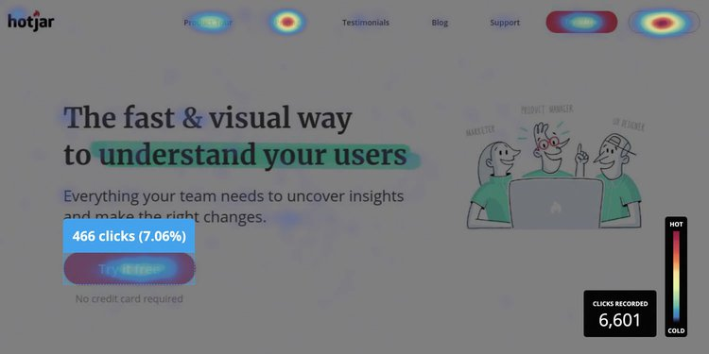
Click Heatmap
Click Map show you an aggregate of where visitors click their mouse on desktop devices and tap their finger on mobile devices (in this case, they are known as touch heatmaps).
The map is color-coded to show the elements that have been clicked and tapped the most (red, orange, yellow)
Notes:
Image Source - https://www.hotjar.com/heatmaps/

Slide 9
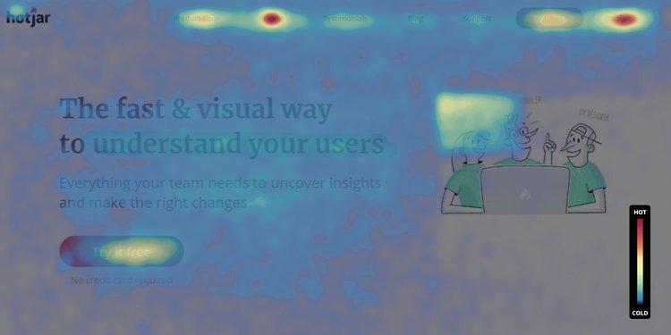
Move Heatmap
Move maps track where desktop users move their mouse as they navigate the page.
The hot spots in a move map represent where users have moved their cursor on a page
Notes:
Image Source - https://www.hotjar.com/heatmaps/

Slide 10
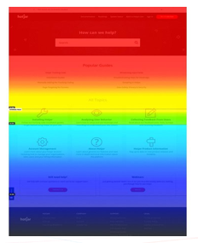
Scroll Maps
Scroll maps show you the exact percentage of people who scroll down to any point on the page: the redder the area, the more visitors saw it.
Notes:
Image Source - https://www.hotjar.com/heatmaps/

Slide 11
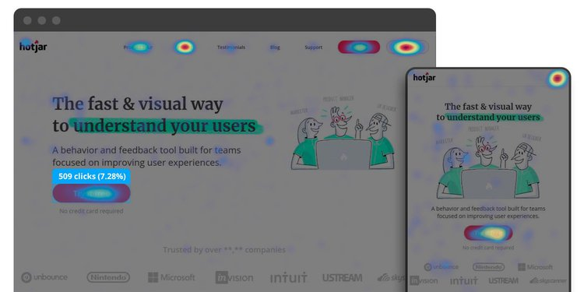
Desktop and Mobile heatmaps
Desktop and mobile heat maps help you compare the performance of your website on different devices. For example, content that is prominent on a desktop page might sit much further below the fold on a phone—and you need to see if interaction differs, and how's

Slide 12
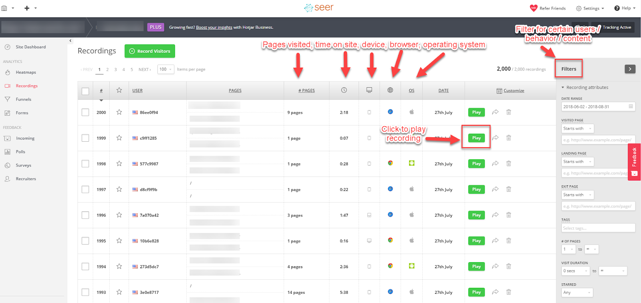
Visitor Recording
Within Hotjar, we are able to capture videos of real users using the site. Within the interface, you are able to filter by pages visited, number of pages visited, time on site, device type, browser, operating system, date, and more.
Notes:
Image Source - https://www.seerinteractive.com/blog/how-hotjar-works/

Slide 13
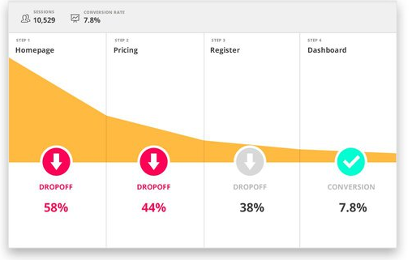
Funnel Conversion
Funnel analysis can help you spot where users are leaving your website, so you can optimize it and increase conversions. To visualize and map the flow of visitors across a set of website pages or events.
Notes:
Image Source - https://www.hotjar.com/blog/funnel-analysis/

Slide 14
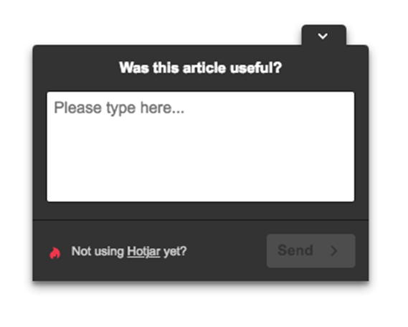
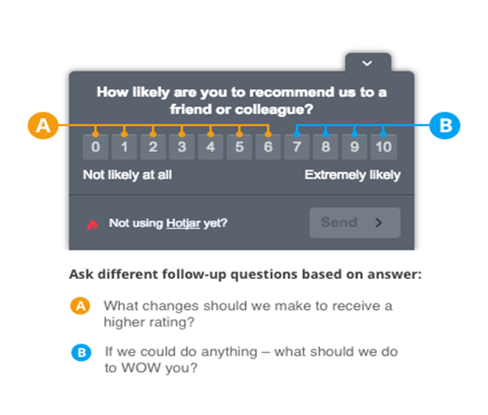
Feedback Polls
Question types & bank
Net Promoter System
Notes:
Image Source - https://www.hotjar.com/feedback-polls/

Slide 15
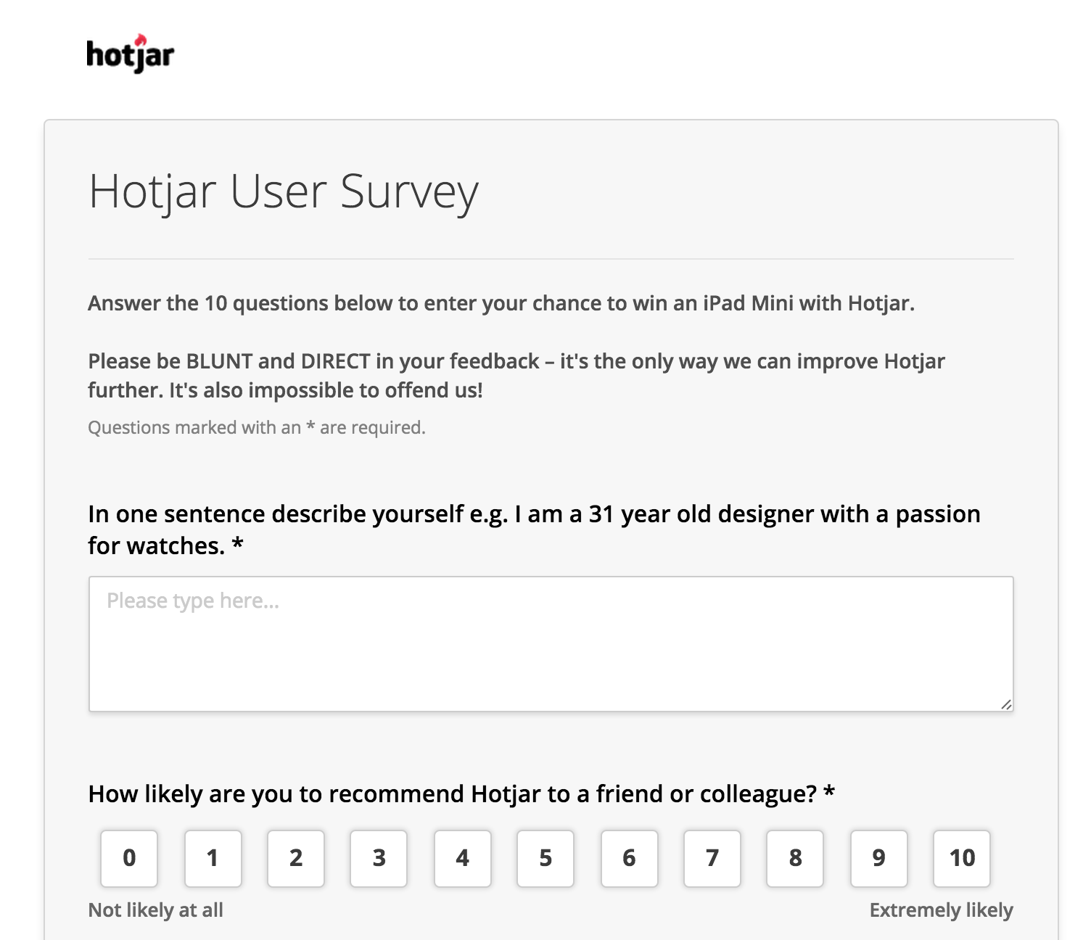
Survey
Hotjar's Surveys allow you to ask your site visitors or customers an unlimited number of questions. Additionally, you can invite people to fill in your survey directly from any page of your site and based on user behavior.
Notes:
Image Source - https://help.hotjar.com/hc/en-us/articles/115011787508-What-is-a-Hotjar-Survey-#:~:text=Hotjar's%20Surveys%20allow%20you%20to,and%20based%20on%20user%20behavior.

Slide 16
References
https://www.hotjar.com/heatmaps/
https://www.hotjar.com/blog/what-is-hotjar/
https://www.seerinteractive.com/blog/how-hotjar-works/
https://www.hotjar.com/blog/funnel-analysis/
https://www.hotjar.com/feedback-polls/
https://help.hotjar.com/hc/en-us/articles/115011787508-What-is-a-Hotjar-Survey
https://www.seerinteractive.com/blog/how-hotjar-works/
https://www.hotjar.com/blog/features-you-may-not-know-about/

Slide 17
Thank You!
For any queries connect me at jatinkochhar@hotmail.com

